Slide 1
HUMAN GENOME
Dec 29 2024
Phuc Loi Luu, PhD
Email: Luu.p.loi@googlemail.com
Zalo: 0901802182

Slide 2
Content
Human Genome Build
Introduction to GENCODE
Introduction to UCSC Genome Browser

Slide 3
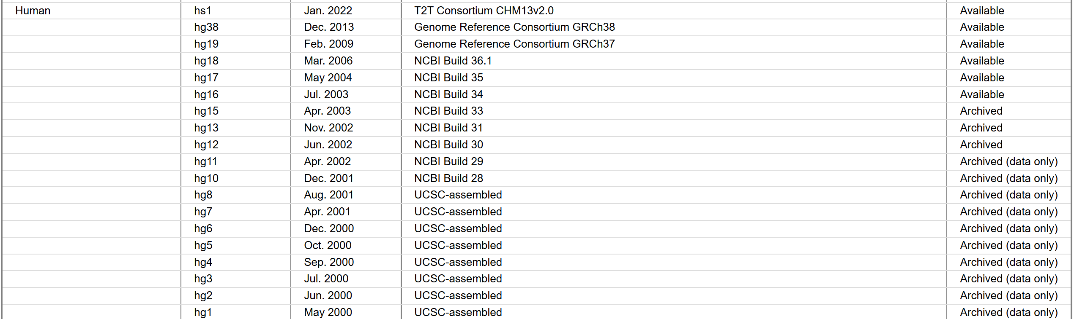
Human Genome Build
https://genome.ucsc.edu/FAQ/FAQreleases.html

Slide 4
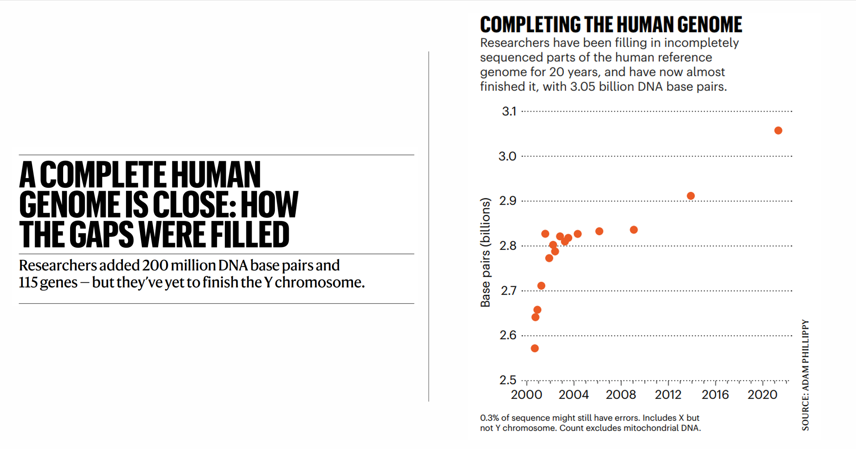

Slide 5
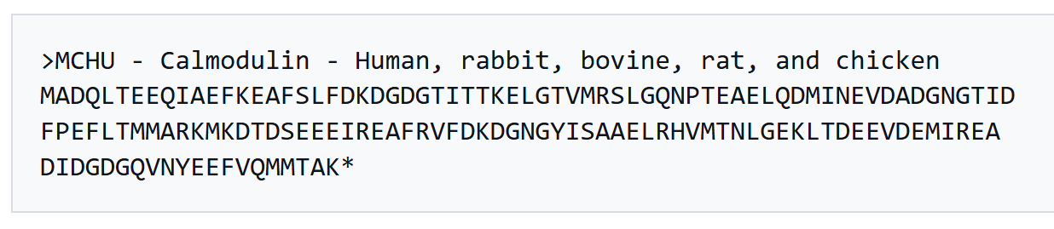
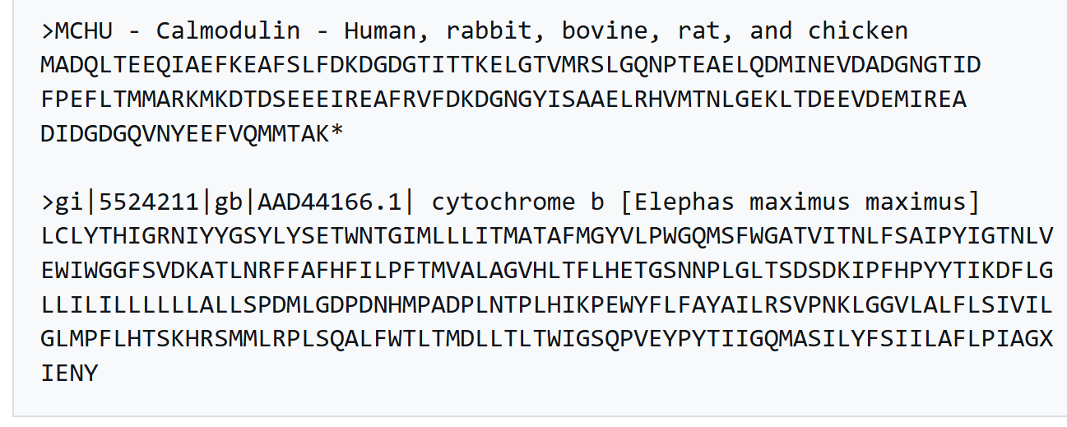
Fasta Format
Single Sequence Fasta Format
Multiple Sequence Fasta Format
https://en.wikipedia.org/wiki/FASTA_format

Slide 6
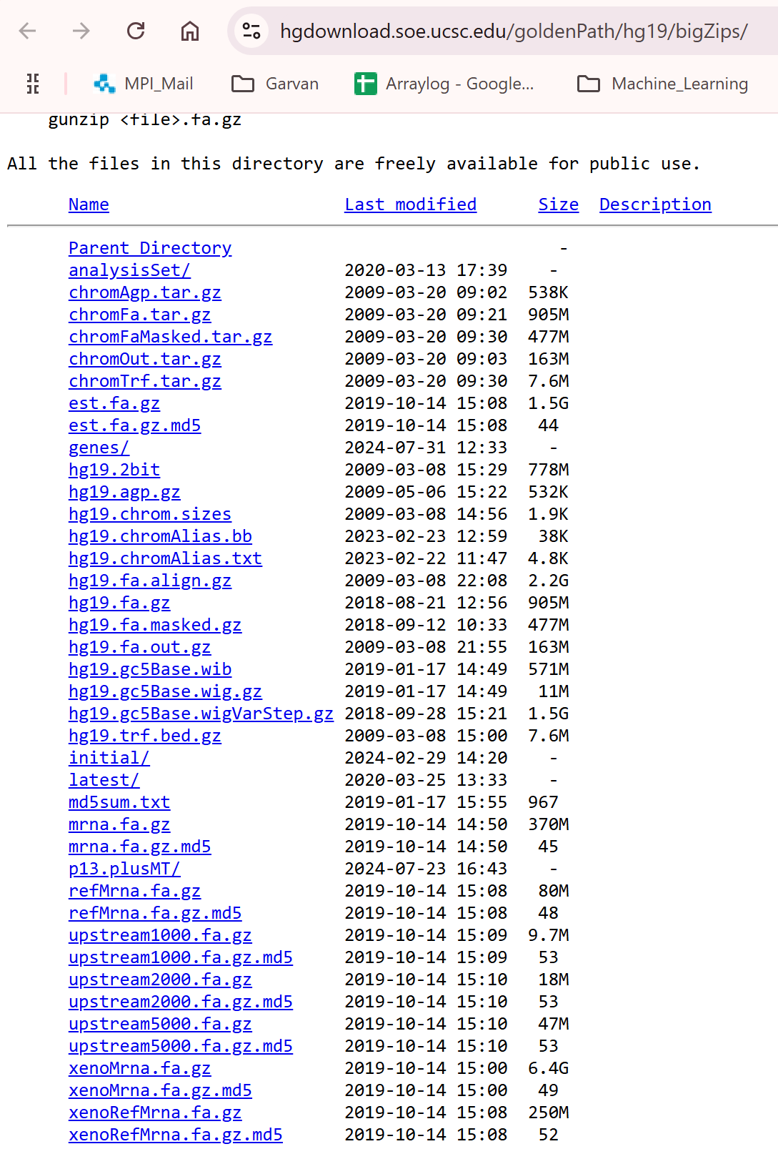
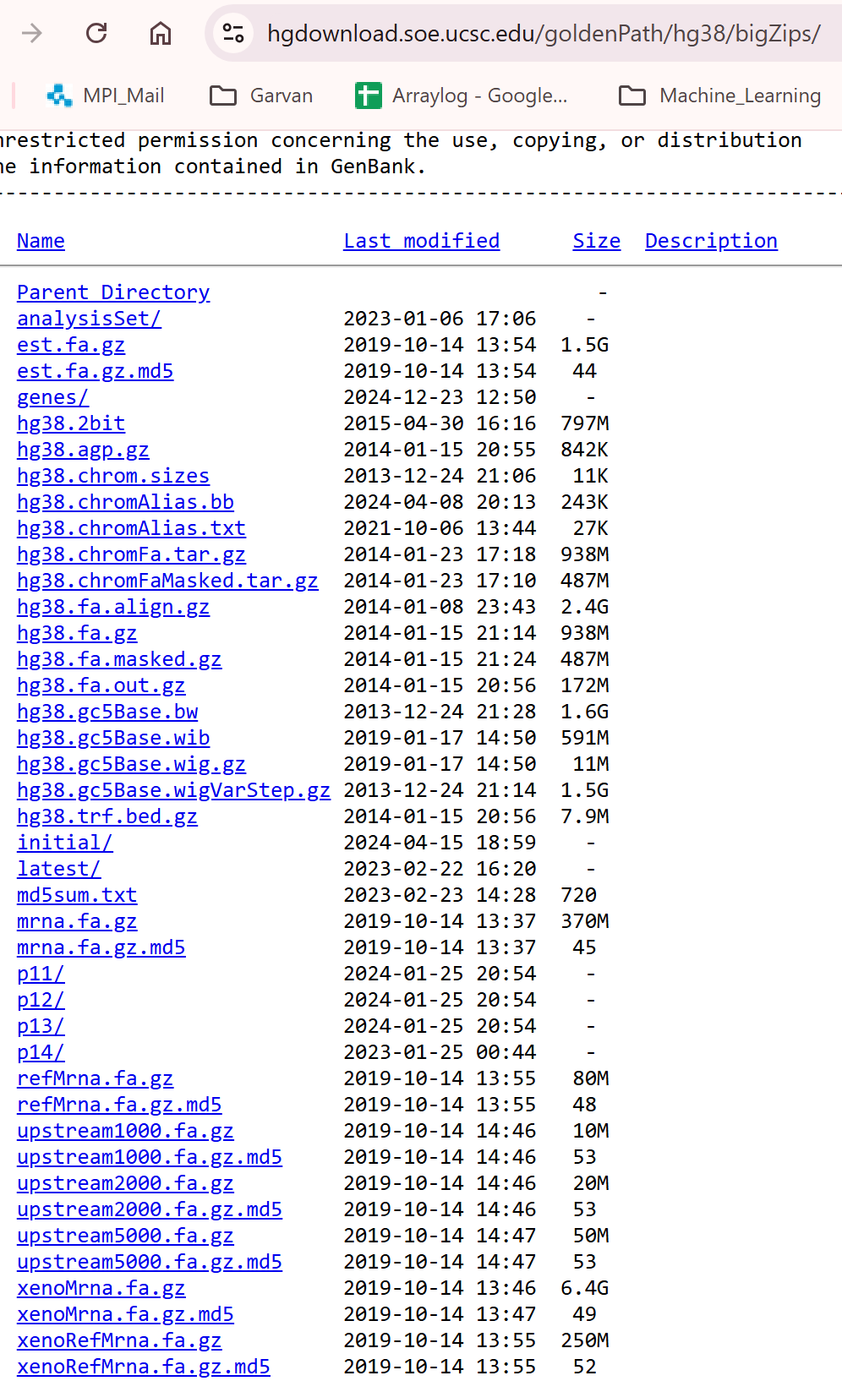
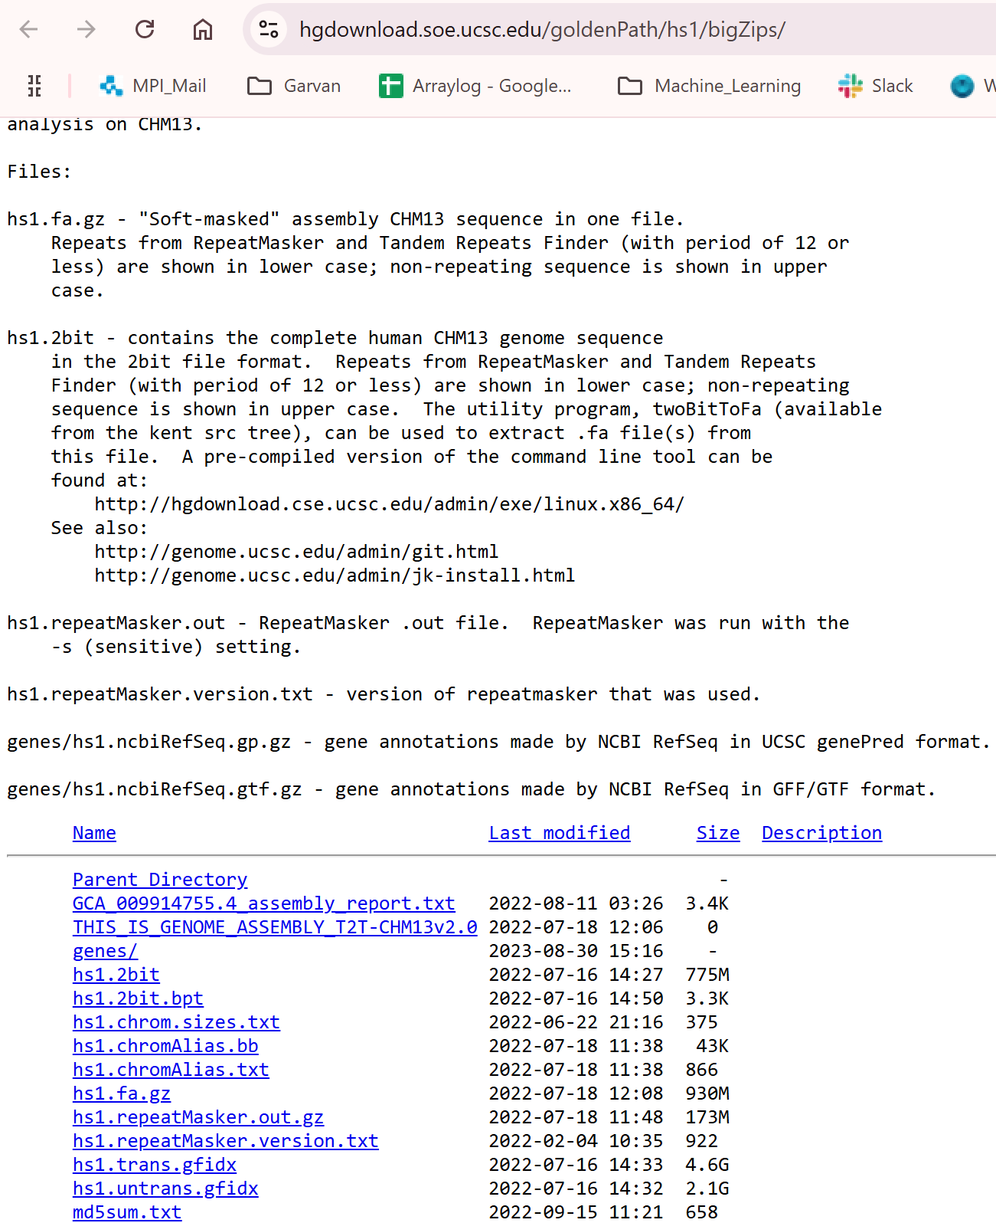
Where to download the reference genomes
https://hgdownload.soe.ucsc.edu/goldenPath/hs1/bigZips/
https://hgdownload.soe.ucsc.edu/goldenPath/hg19/bigZips/
https://hgdownload.soe.ucsc.edu/goldenPath/hg38/bigZips/

Slide 7
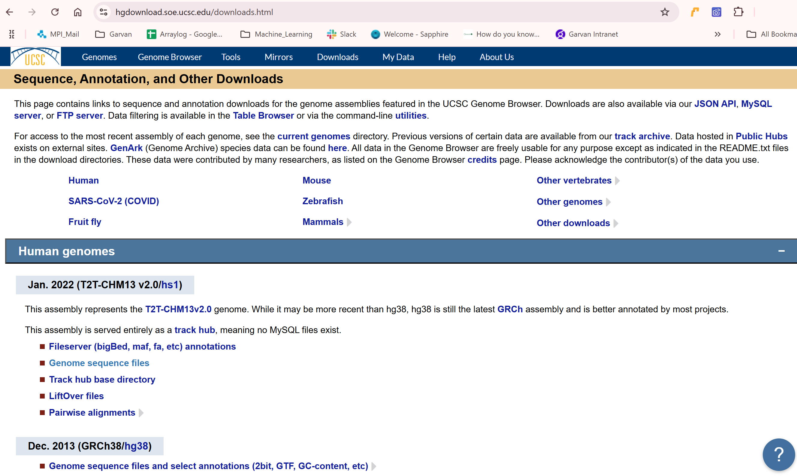
Where to download the reference genomes
https://hgdownload.soe.ucsc.edu/downloads.html

Slide 8
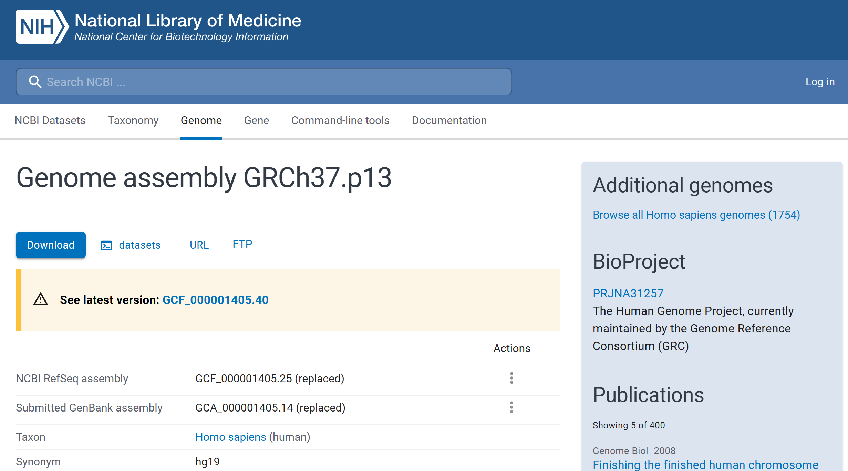
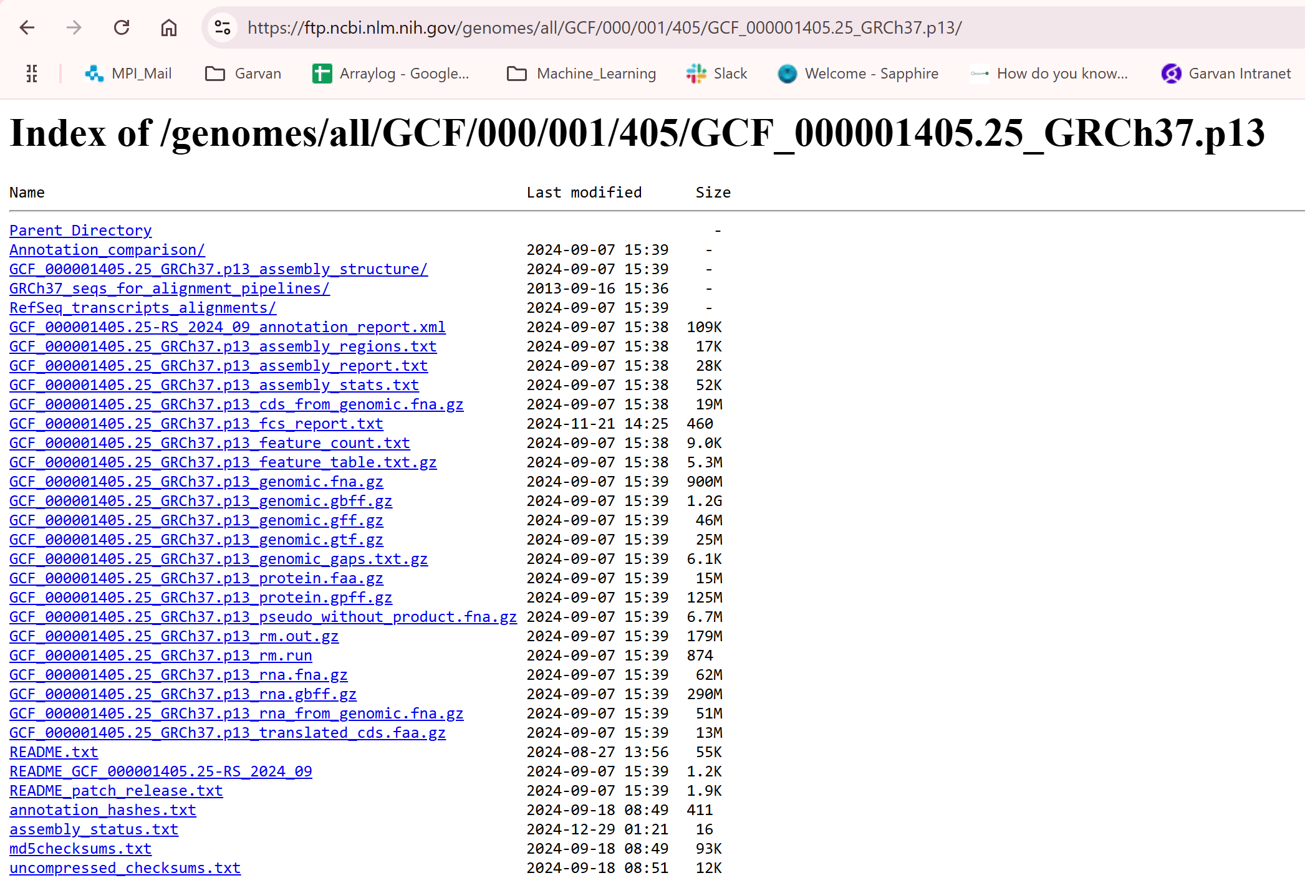
Where to download the reference genomes
https://www.ncbi.nlm.nih.gov/datasets/genome/GCF_000001405.25/
https://ftp.ncbi.nlm.nih.gov/genomes/all/GCF/000/001/405/GCF_000001405.25_GRCh37.p13/

Slide 9
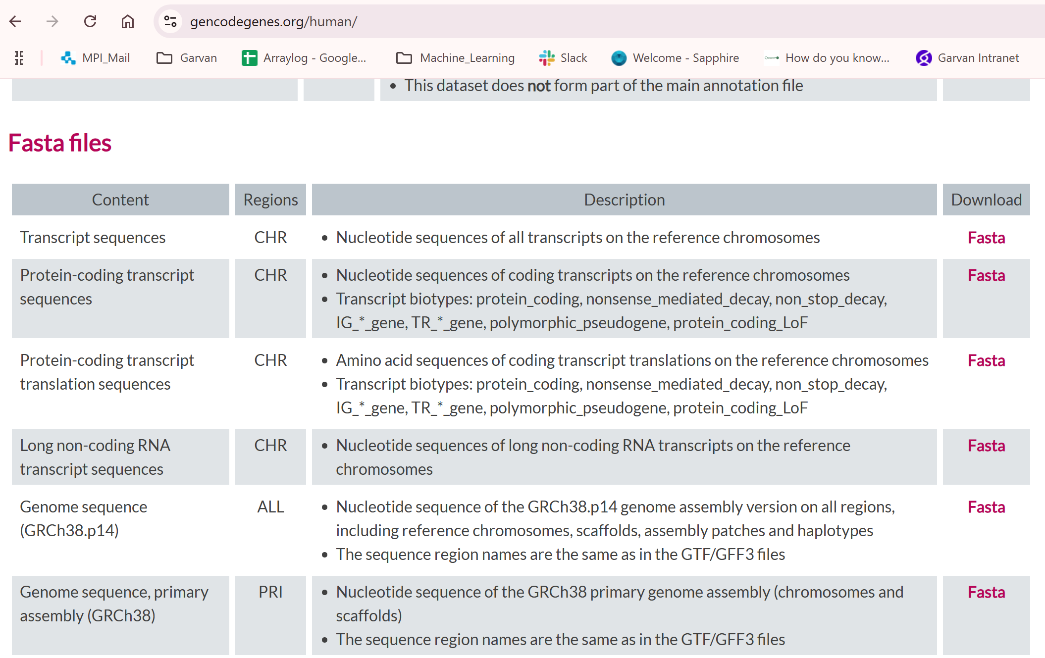
Where to download the reference genomes
https://www.gencodegenes.org/human/

Slide 10
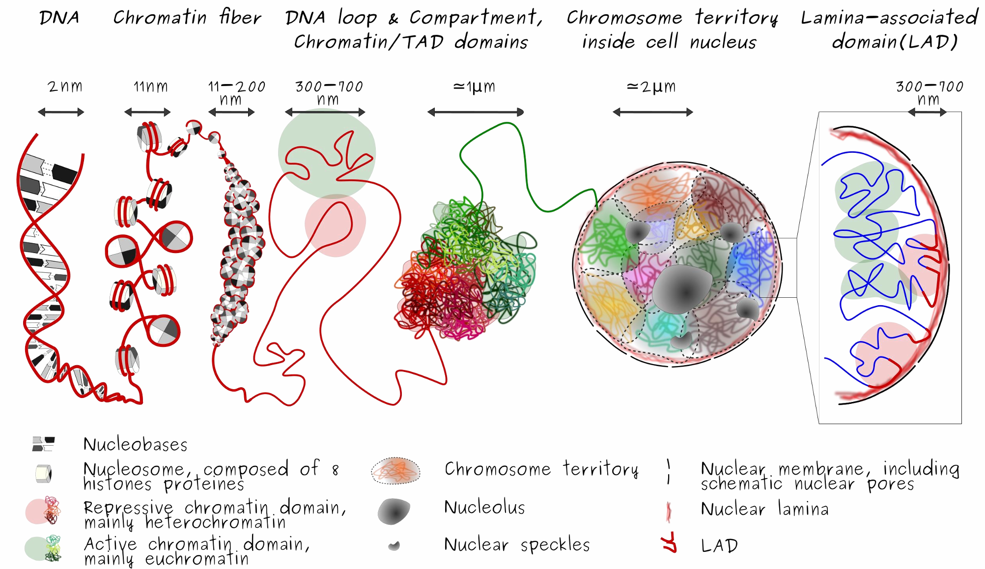
Human Genome Organization
index_3DOrgGenome_SquareShape.png (2523×1422)

Slide 11
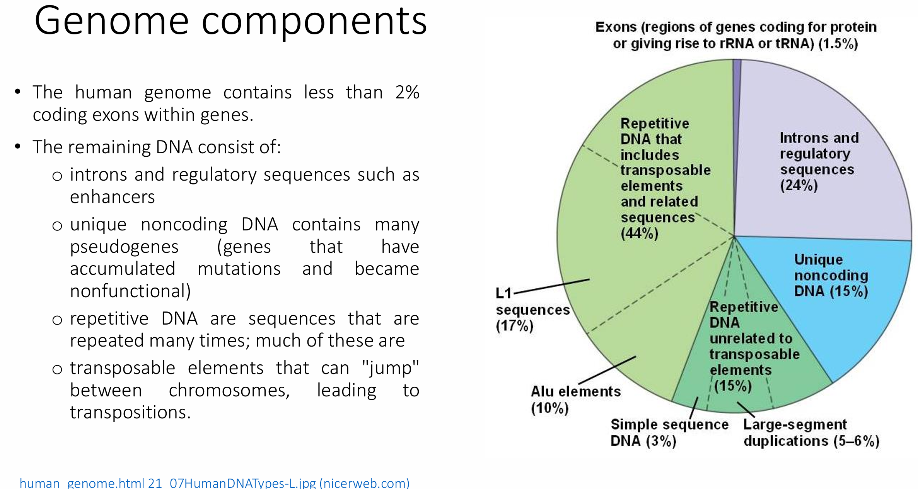

Slide 12
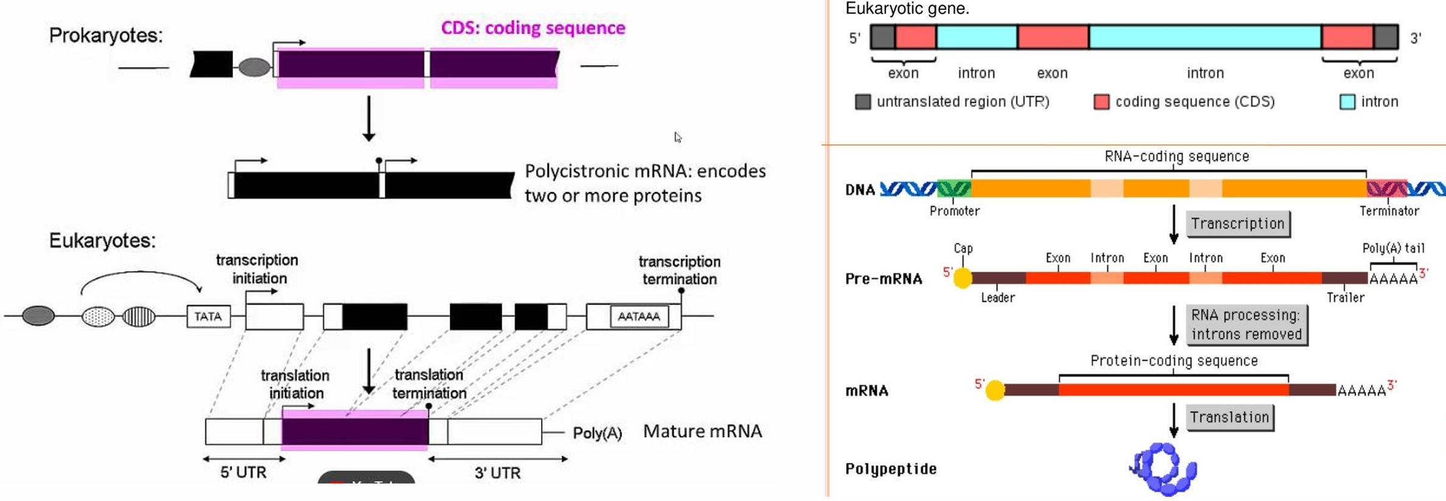
Gene structure

Slide 13
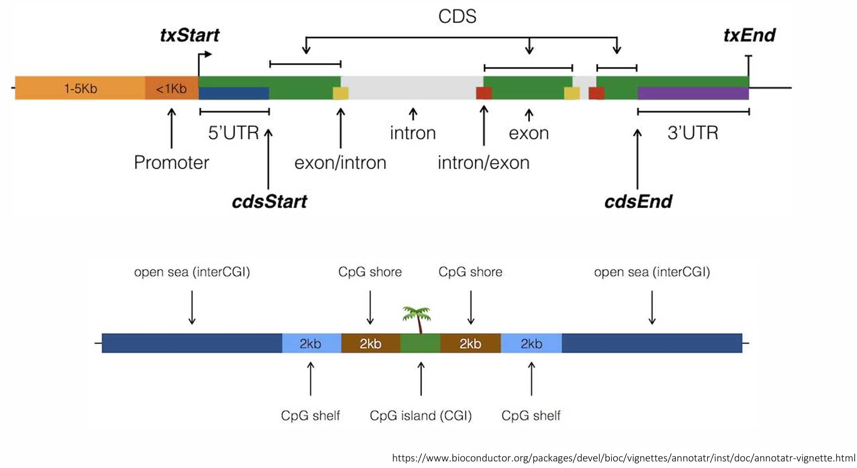
Gene structure

Slide 14
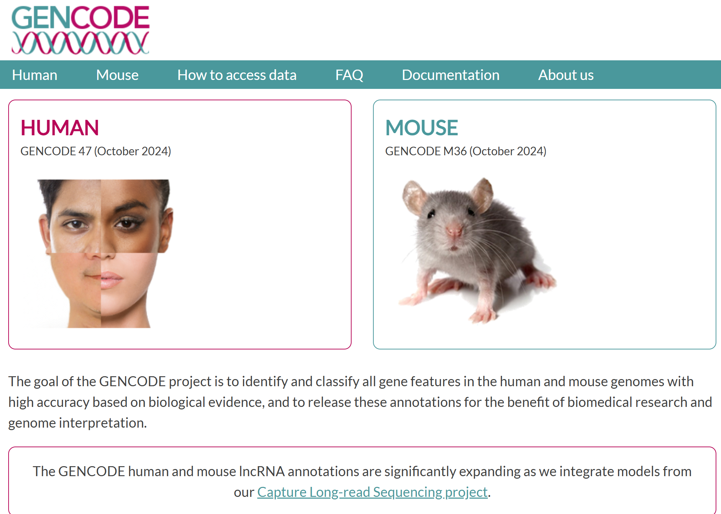
Understanding Gene Annotation through GENCODE (https://www.gencodegenes.org/)

Slide 15
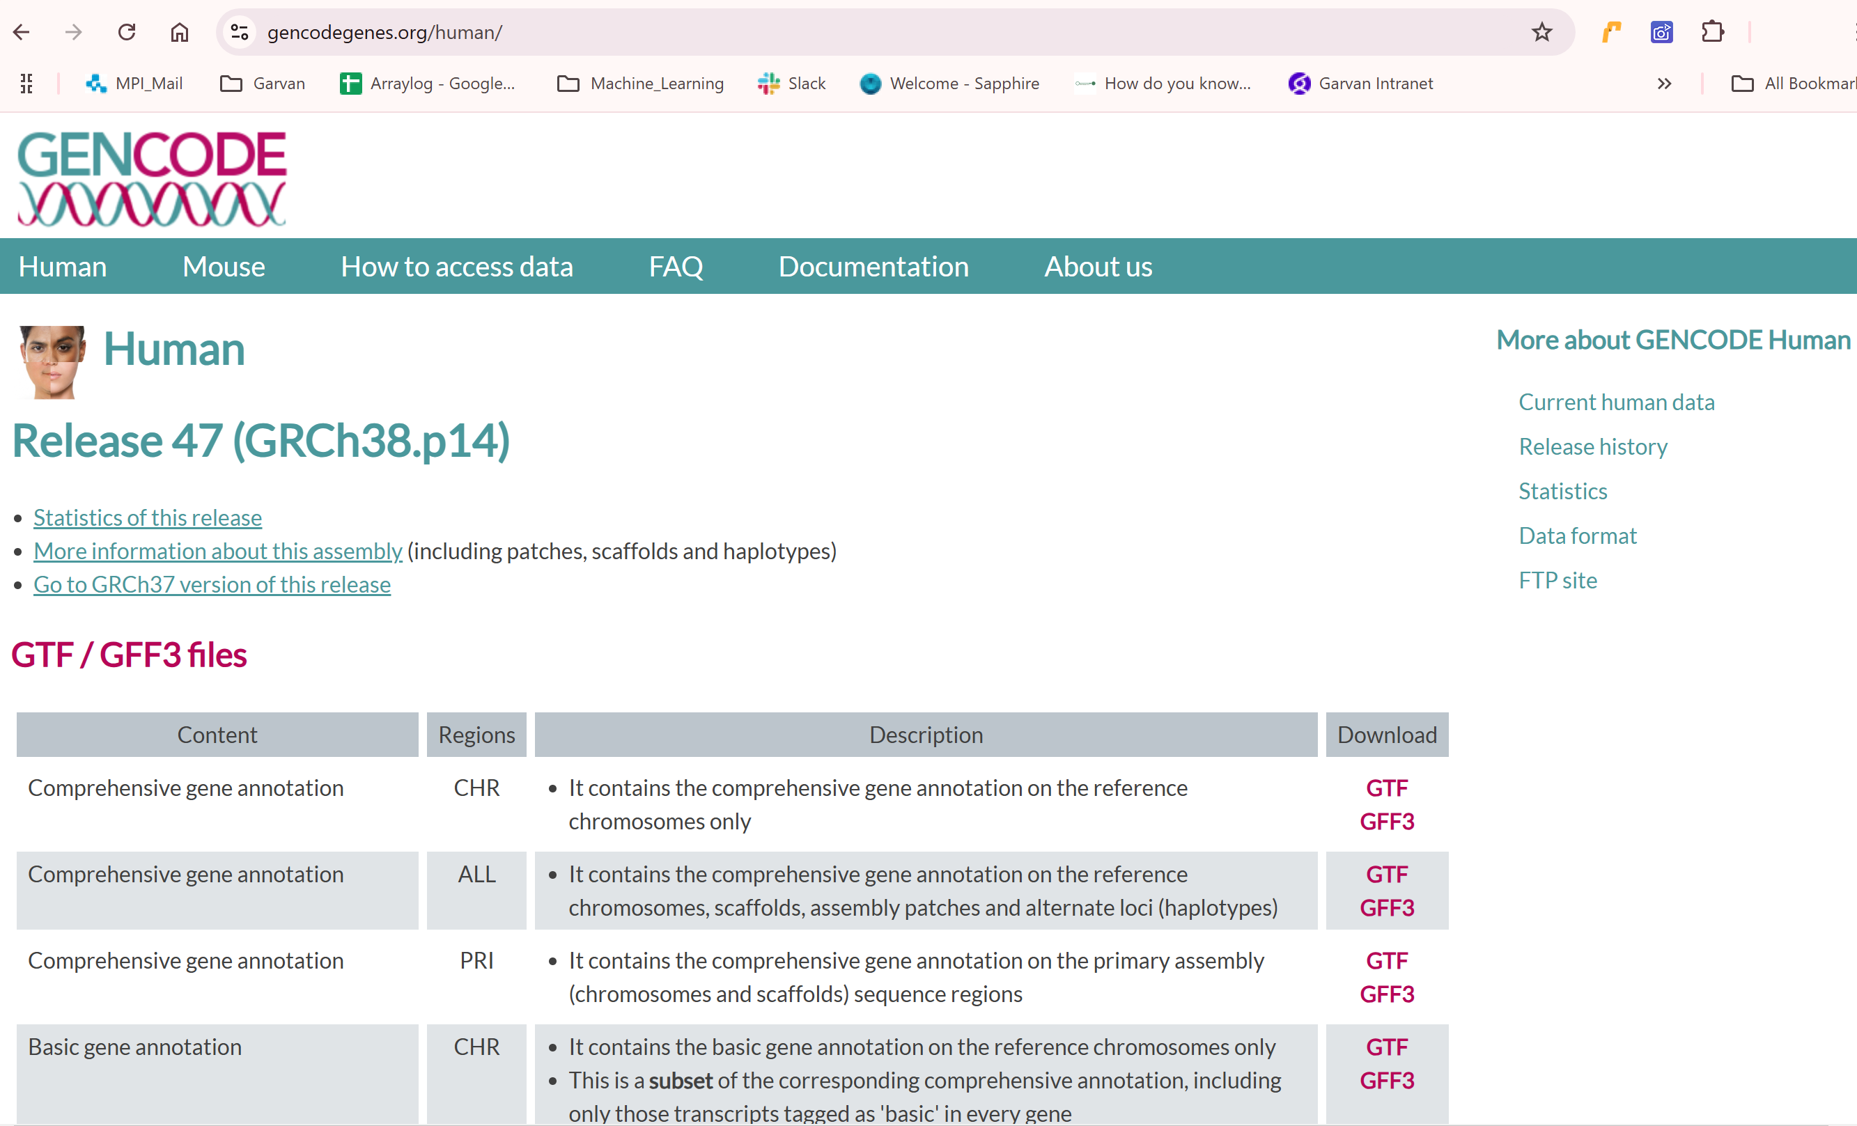
Understanding Gene Annotation through GENCODE
https://www.gencodegenes.org/human/

Slide 16
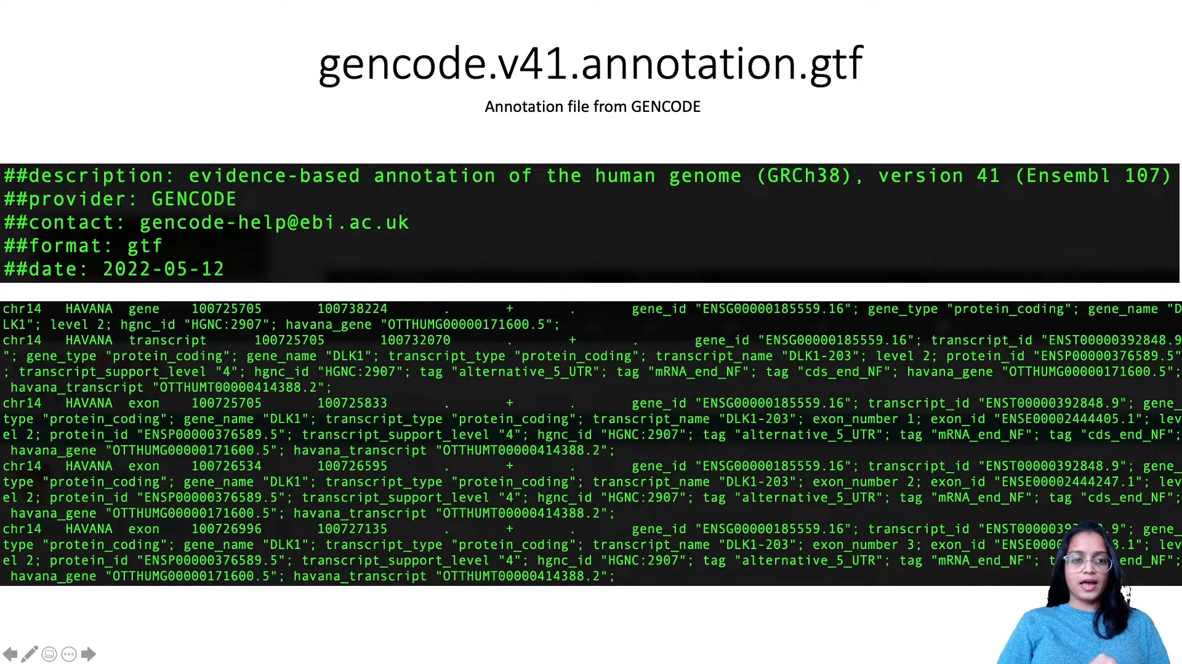
GTF (General Feature Format): 9 columns of data
https://www.youtube.com/watch?v=2Y7zxh1BiFs

Slide 17
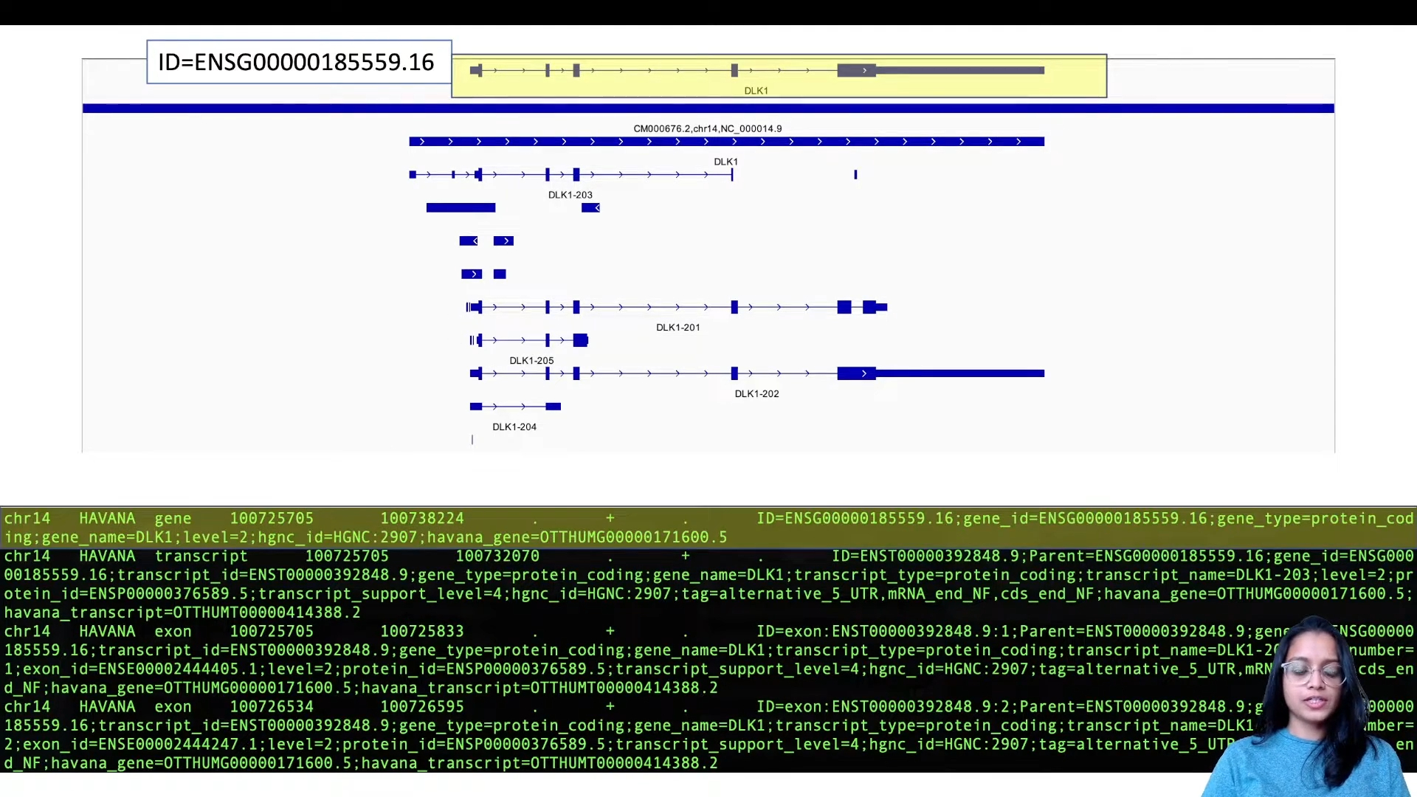
Understanding Gene Annotation through GENCODE
https://www.youtube.com/watch?v=2Y7zxh1BiFs

Slide 18
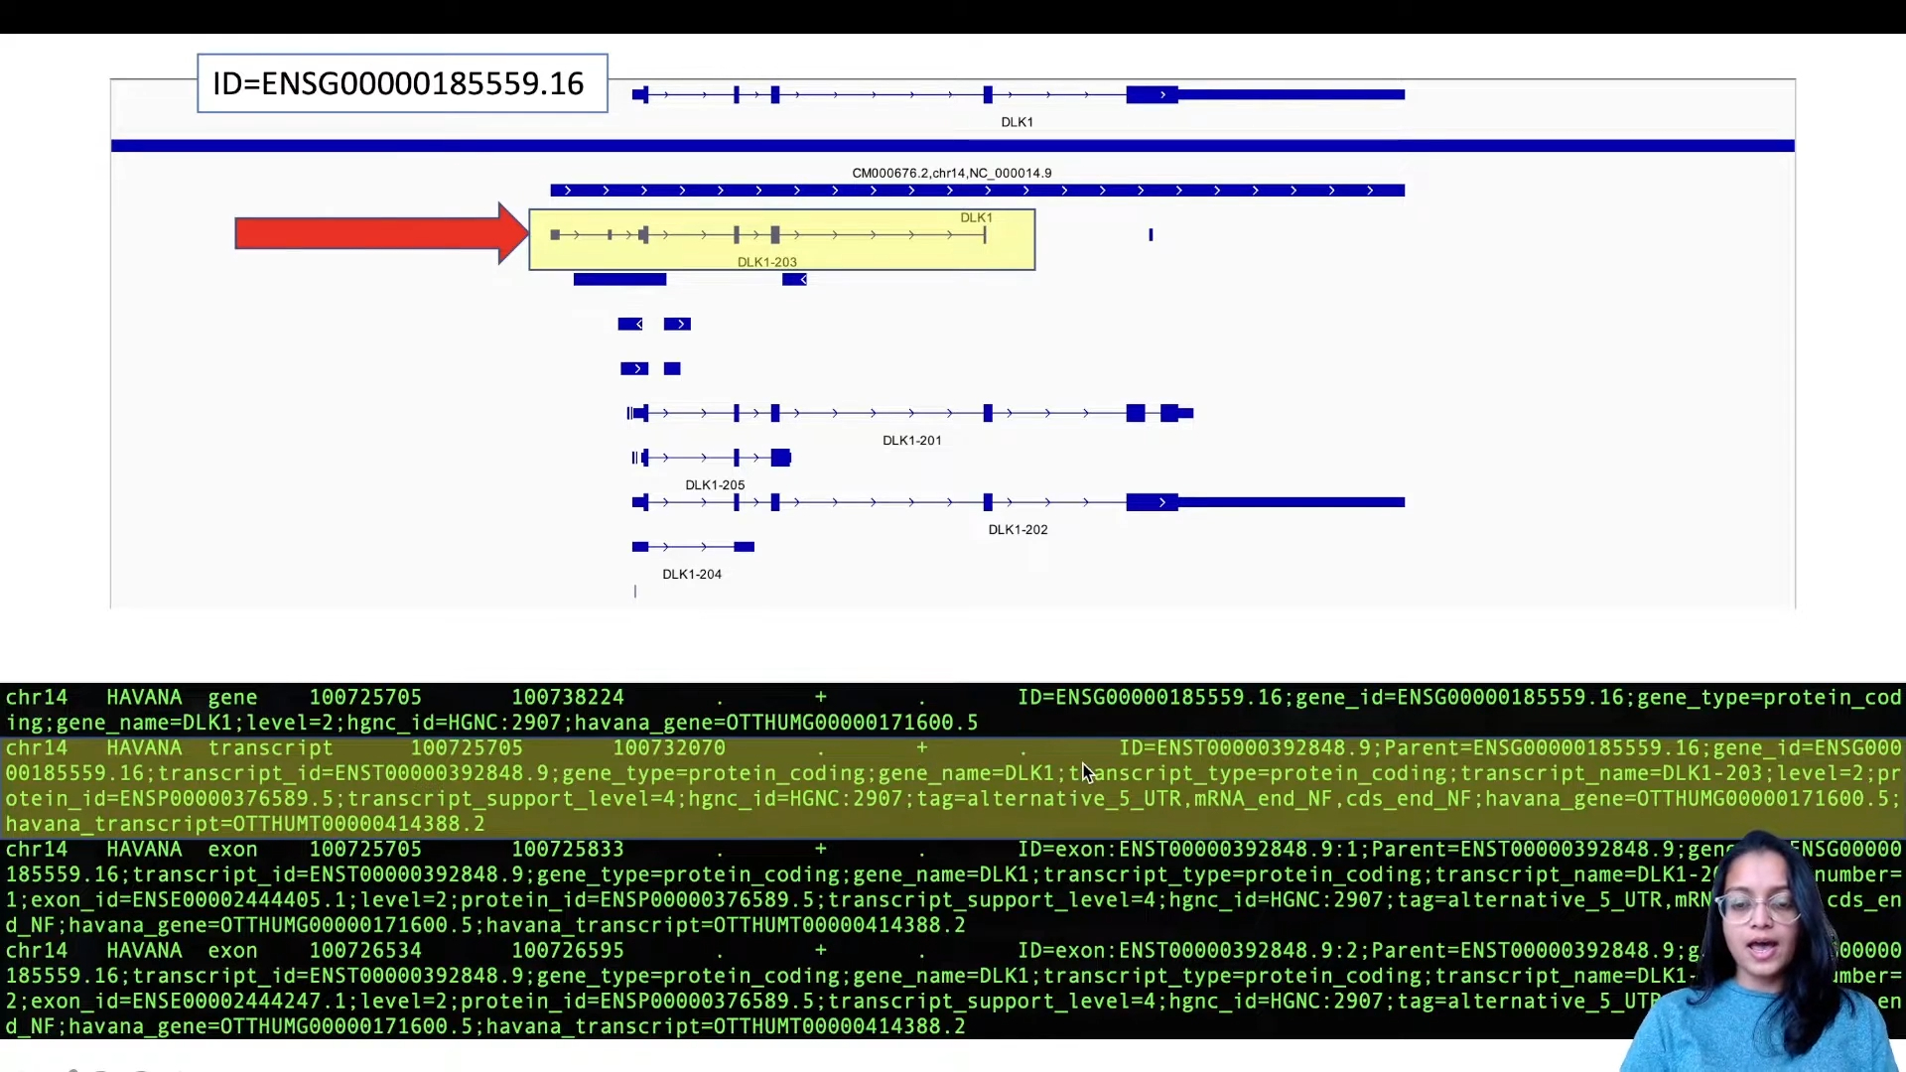
Understanding Gene Annotation through GENCODE
https://www.youtube.com/watch?v=2Y7zxh1BiFs

Slide 19
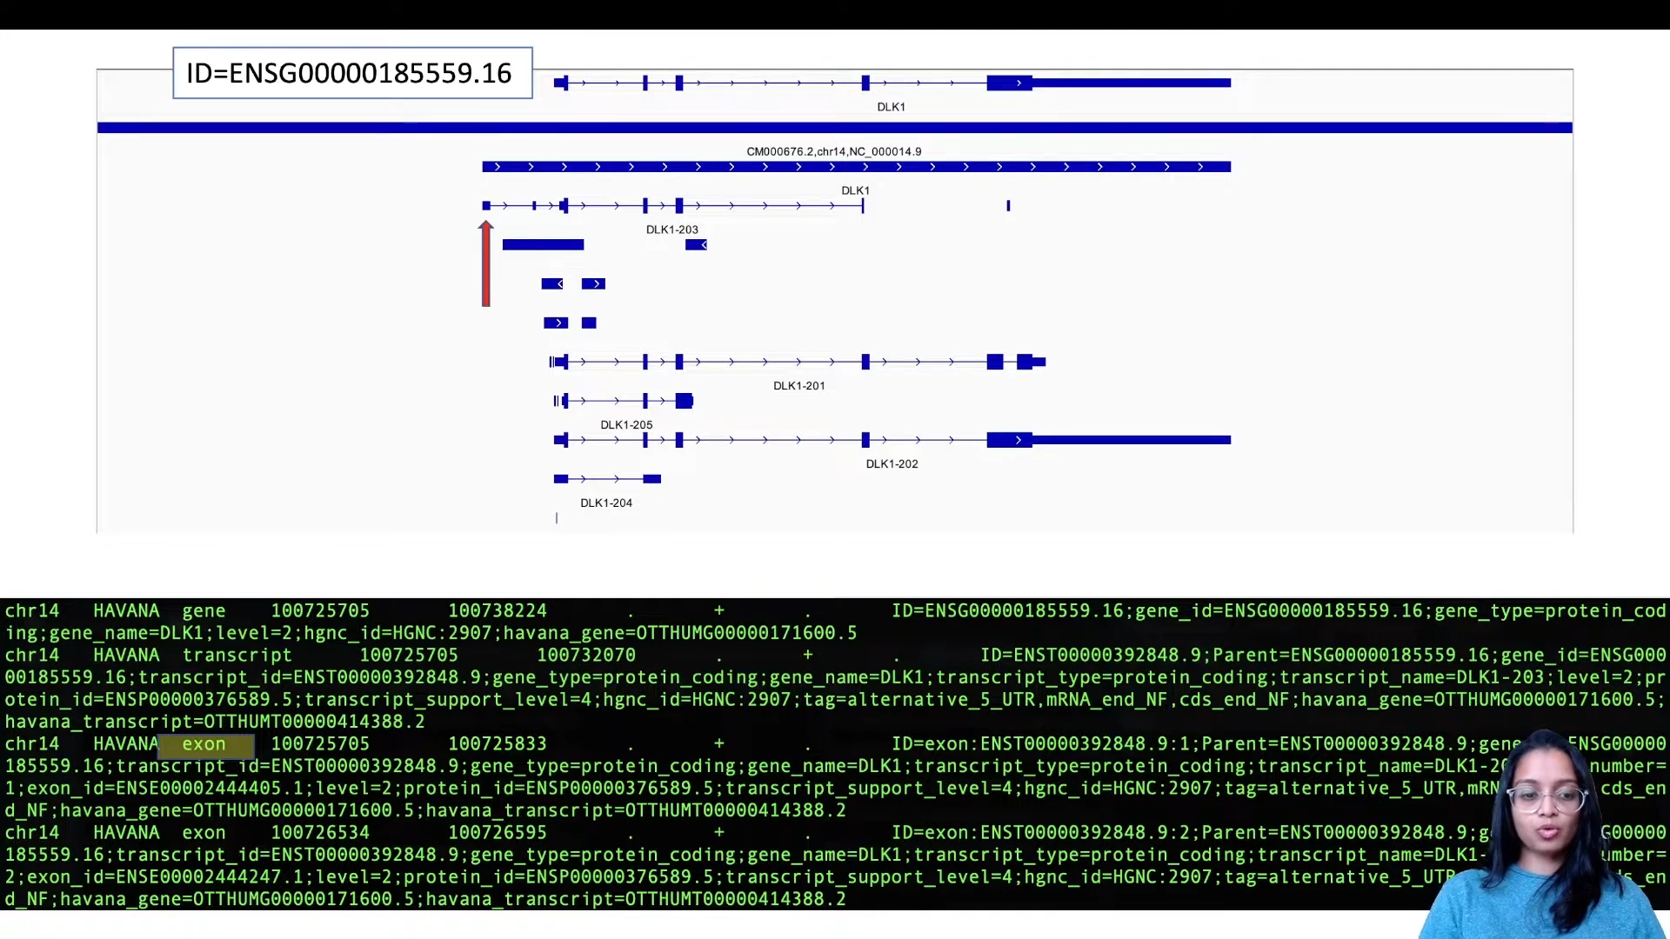
Understanding Gene Annotation through GENCODE
https://www.youtube.com/watch?v=2Y7zxh1BiFs

Slide 20
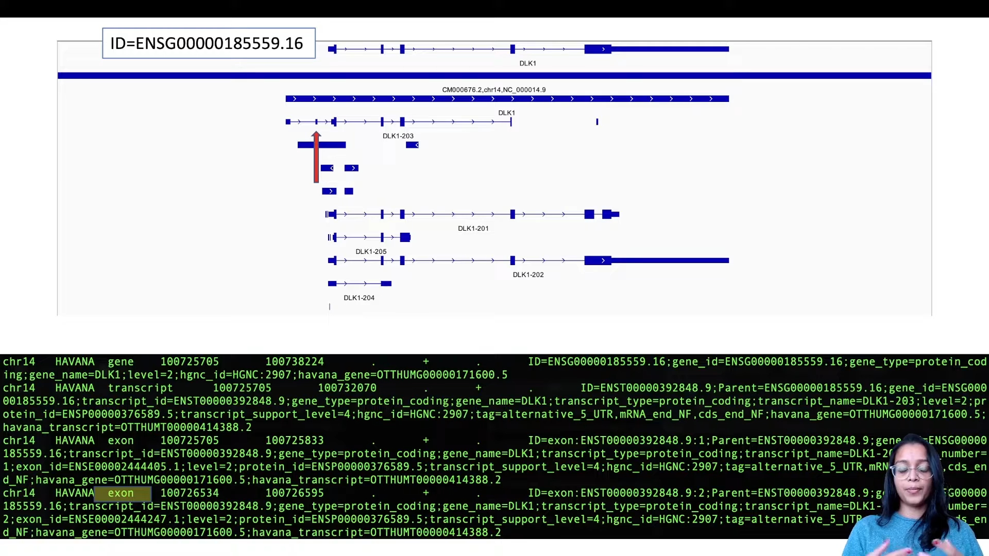
Understanding Gene Annotation through GENCODE
https://www.youtube.com/watch?v=2Y7zxh1BiFs

Slide 21
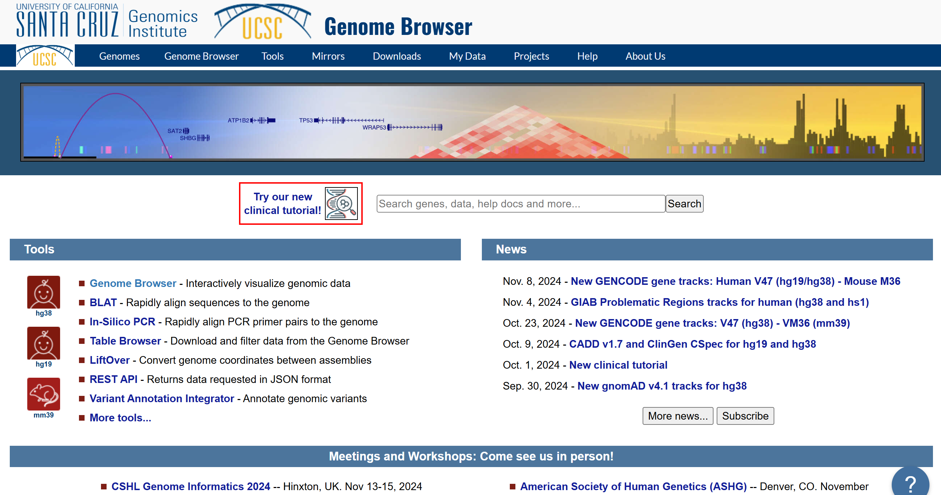
Introduction to UCSC Genome Browser
https://genome.ucsc.edu/index.html

Slide 22
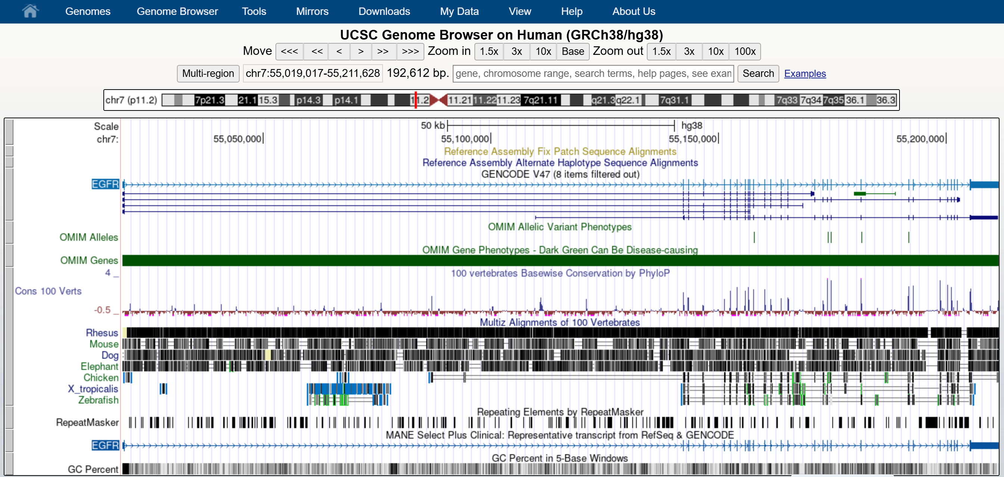
Introduction to UCSC Genome Browser
https://genome.ucsc.edu/cgi-bin/hgTracks?db=hg38&lastVirtModeType=default&lastVirtModeExtraState=&virtModeType=default&virtMode=0&nonVirtPosition=&position=chr7%3A55019017%2D55211628&hgsid=2410221991_gQpMUpHGCVZMeYat2VhYyvvaQEGY

Slide 23
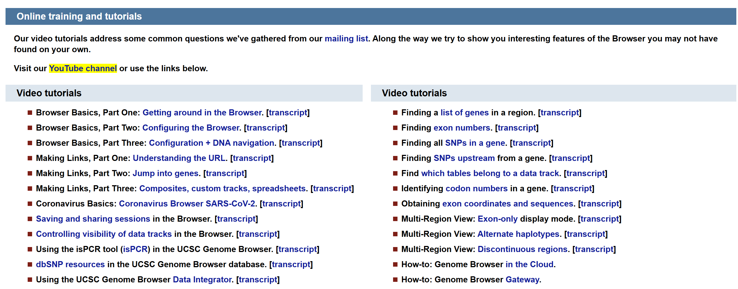
Getting Help with the UCSC Genome Browser
https://genome.ucsc.edu/training/

Slide 24
Xin chân thành cảm ơn!
Luu Phuc Loi, PhD
Zalo: 0901802182
luu.p.loi@googlemail.com

